Slide 1
Session 7.1 Performance 2 – Indexes
IN705 Databases 3 - 2018
Notes:
Today we will talk about what we must consider wrt the physical layout of the database on disk
Next time we talk about query optimisation.

Slide 2
Indexing
Caution: Different authors use the terminology of indexing slightly differently
Notes:
Of all the things on that list of “stuff you can do”, the safest is indexing. It is also the one over which you have the most direct and flexible control.
So we will spend more time on it than on any of the others. We will talk about them briefly at the end.
So, make sure you have the concepts clear, and be aware that there may be these conflicts
When discussing indexing, make sure that everyone is talking about the same thing.
Primary Index: On a primary key. If dense, will be 1-1 entry to record relationship. Can be sparse if file is ordered on the primary key, having one index entry for each block. These are guaranteed to be unique values, as each record has a unique value on this field.
Clustering Index: On the field that determines the sort order of the file, but need not be primary (and therefore need not be unique). Retrieval therefore not guaranteed to be 1-1, and file must be traversed to change in field value. Has an entry for every distinct value of the field, although not necessarily for every record (if there are duplicates, there will be fewer values than records). Does this make it sparse or dense?
Secondary index: On a non-primary key and non-sort-order key. Must therefore have one entry for each record (i.e. it is dense)
Primary: One entry for each block
Clustering: One entry for each value
Secondary: One entry for each record if the index is a candidate key, or each block of pointers to records having the same value, otherwise

Slide 3
Searching
Name | Capitol | Population | Bird | Flower | Insect
Rhode Island | Providence | 1,048,319 | Rhode Island Red | Violet | --
Arizona | Phoenix | 5,130,632 | Cactus Wren | Saguaro Cactus Blossom | Swallowtail butterfly
Vermont | Montpelier | 608,827 | Hermit Thrush | Red Clover | Honey bee
Hawaii | Honolulu | 1,211,537 | Nene | Hibiscus | --
Alaska | Juneau | 626,932 | Willow Ptarmigan | Forget Me Not | Skimmer dragonfly
California | Sacramento | 33,871,648 | California Valley Quial | California Poppy | Dogface butterfly
Kansas | Topeka | 2,688,418 | Western Meadowlark | Sunflower | Honey bee
Idaho | Boise | 1,293,953 | Mountain Bluebird | Syringa | Monarch butterfly
Alabama | Montgomery | 4,447,100 | Yellow Hammer | Camellia | Monarch butterfly
New york | Albany | 18,976,457 | Bluebird | Rose | Ladybug
Arkansas | Little Rock | 2,675,400 | Mockingbird | Apple Blossom | Honey bee
………
Notes:
Let’s assume that for some reason, you have to deal with this database about the United States.
There are exactly 50 individual states in the U.S., each with its own capitol, state bird, state flower, state insect and, of course, population.
You have a sort of ordinary table of information for a state record, and it is stored in a heap (that is unordered).
The first bit of the table looks like this…
Assuming that the table is in random order on disk, what is the algorithm required to find a particular record, say, Hawaii?
Linear search – you would have to start at the beginning and look at every record until you found Hawaii in the Name field, or you reached the end of the records. On a bad day, Hawaii might be record 50 and you would have to look at the whole table
If the table was large, you would pull in an awful lot of data from disk before you found what you wanted
(Note, this example only has 50 records in it for the sake of clarity; always keep in mind though, that production databases can have millions and millions of records.)
If you think about it, though, to find the Hawaii record, you don’t need the whole record, you only need the name field.
Imagine instead that we had a structure like this:

Slide 4
Searching
Name
Alabama
Alaska
Arizona
Arkansas
California
….
Hawaii
Idaho
….
Kansas
….
New york
….
Rhode Island
….
Vermont
Name | Capitol | Population | Bird | Flower | Insect
Rhode Island | Providence | 1,048,319 | Rhode Island Red | Violet | --
Arizona | Phoenix | 5,130,632 | Cactus Wren | Saguaro Cactus Blossom | Swallowtail butterfly
Vermont | Montpelier | 608,827 | Hermit Thrush | Red Clover | Honey bee
Hawaii | Honolulu | 1,211,537 | Nene | Hibiscus | --
Alaska | Juneau | 626,932 | Willow Ptarmigan | Forget Me Not | Skimmer dragonfly
California | Sacramento | 33,871,648 | California Valley Quial | California Poppy | Dogface butterfly
Kansas | Topeka | 2,688,418 | Western Meadowlark | Sunflower | Honey bee
Idaho | Boise | 1,293,953 | Mountain Bluebird | Syringa | Monarch butterfly
Alabama | Montgomery | 4,447,100 | Yellow Hammer | Camellia | Monarch butterfly
New york | Albany | 18,976,457 | Bluebird | Rose | Ladybug
Arkansas | Little Rock | 2,675,400 | Mockingbird | Apple Blossom | Honey bee
………
Notes:
The ellipsis indicate fields that are not displayed
This structure has all 50 state names, in alphabetical order
For each one, it has a pointer to the address of disk of the associated record.
To find the record for, say, Hawaii, you look up Hawaii in this little name table, and have directly its address on disk
No unused bits, other than the names are pulled in

Slide 5
Searching
Name
Alabama
Alaska
Arizona
Arkansas
California
….
Hawaii
Idaho
….
Kansas
….
New york
….
Rhode Island
….
Vermont
Can all be held in main memory
Can use a binary search algorithm
Worst case log₂(n)
Index
Notes:
So instead of searching the whole database, we just search this little table, which is going to be much faster for a number of reasons
Main memory: No matter how many columns there are in the database, this table will have only the search key
Binary search. Usual phone book analogy and explanation of O(log n) complexity.
This little table – a sorted set of search key values with pointers to record addresses -- is called an index
When you create a table in MSSQL, it automatically makes an index on the primary key (we’ll talk later about other indices) and uses it in queries to speed up retrieval.

Slide 6
Index
Name | Capitol | Population | Bird | Flower | Insect
Alabama | Montgomery | 4,447,100 | Yellow Hammer | Camellia | Monarch butterfly
Alaska | Juneau | 626,932 | Willow Ptarmigan | Forget Me Not | Skimmer dragonfly
Arizona | Phoenix | 5,130,632 | Cactus Wren | Saguaro Cactus Blossom | Swallowtail butterfly
Arkansas | Little Rock | 2,675,400 | Mockingbird | Apple Blossom | Honey bee
California | Sacramento | 33,871,648 | California Valley Quial | California Poppy | Dogface butterfly
….
Hawaii | Honolulu | 1,211,537 | Nene | Hibiscus | --
Idaho | Boise | 1,293,953 | Mountain Bluebird | Syringa | Monarch butterfly
….
Kansas | Topeka | 2,688,418 | Western Meadowlark | Sunflower | Honey bee
….
New york | Albany | 18,976,457 | Bluebird | Rose | Ladybug
….
Rhode Island | Providence | 1,048,319 | Rhode Island Red | Violet | --
….
Vermont | Montpelier | 608,827 | Hermit Thrush | Red Clover | Honey bee
Alabama
California
Florida
Iowa
Montana
Pennsylvania
Vermont
Notes:
But what if instead of 50 records, you have millions.
For example, the Internal Revenue Service in the United States has a database with 400,000,000 records.
Even a single field index (on SSN, say) would get huge.
It would spread across blocks on disk and be slow to process.
So we would like to make our index smaller.
One way to do this is to keep only some of the values, like this.
How can you speed up access to the table with this kind of index?
How can you even find Hawaii, since it’s not in the index?
Ponder, ponder….
What if the database table itself is stored sorted.
Each value in the index points to its guy. Alabama to Alabama, California to California, Montana to Montana, etc.
What’s the algorithm for retrieval now?
Find the value in the index that’s after you in the alphabet
Use the one right before him
Go where it points
Search the table until you find what you’re looking for, or hit the next “pointed to” entry (in which case it’s not in the database)

Slide 7
Index
Dense
Index contains an entry for every record in the database
Sparse
Index contains entries for only some of the records in the database
Notes:
So we’ve seen these two approaches

Slide 8
Dense or Sparse?
Sparse index requires more rows to be fetched from the database.
Dense index requires more space for index and, consequently, longer search time to find index entry.
Notes:
Putting together the sparse/dense distinction with what you know about how magnetic disks work, can you come up with a good scheme?

Slide 9
Hint
Remember that the bottleneck in disk access is the seek (finding the block), not the read (transferring the contents)

Slide 10
Effective Indexing
Alabama | Montgomery | 4,447,100 | Yellow Hammer | Camellia | Monarch butterfly
Alaska | Juneau | 626,932 | Willow Ptarmigan | Forget Me Not | Skimmer dragonfly
Arizona | Phoenix | 5,130,632 | Cactus Wren | Saguaro Cactus Blossom | Swallowtail butterfly
Arkansas | Little Rock | 2,675,400 | Mockingbird | Apple Blossom | Honey bee
Block 1
Alabama
California
Idaho
New York
California | Sacramento | 33,871,648 | California Valley Quial | California Poppy | Dogface butterfly
….
Hawaii | Honolulu | 1,211,537 | Nene | Hibiscus | --
Block 2
Idaho | Boise | 1,293,953 | Mountain Bluebird | Syringa | Monarch butterfly
….
Kansas | Topeka | 2,688,418 | Western Meadowlark | Sunflower | Honey bee
….
Block 3
New york | Albany | 18,976,457 | Bluebird | Rose | Ladybug
….
Rhode Island | Providence | 1,048,319 | Rhode Island Red | Violet | --
Block 4
Notes:
Choose your sparse index entries so that each one points to the record at the start of a block of memory.
It thus takes you only one seek to get any record in the database.
(Note those blocks of memory are all the same size; just having trouble getting Powerpoint to cooperate

Slide 11
Types of Index
Assume the table is sorted.
Database and index are in the same sort order
Primary Index:
Index is on primary or candidate key
Will be only one record for each index entry
Clustered index
Index is on a non-candidate key
May be multiple records for a single index entry
Notes:
The first two:
Think a bit about how the implementation and algorithm are different for the clustered index as opposed to the primary.

Slide 12
Types of Index
What about the other (non sort key) fields?
If we often do queries based on another field, we can gain efficiency by indexing on that field.
This is called a “secondary index”
Notes:
The third one
Can we index on, say State Capitol?
Sure.

Slide 13
Secondary Index
Albany
….
Boise
…..
Honolulu
….
Juneau
…
Name | Capitol | Population | Bird | Flower | Insect
Alabama | Montgomery | 4,447,100 | Yellow Hammer | Camellia | Monarch butterfly
Alaska | Juneau | 626,932 | Willow Ptarmigan | Forget Me Not | Skimmer dragonfly
Arizona | Phoenix | 5,130,632 | Cactus Wren | Saguaro Cactus Blossom | Swallowtail butterfly
Arkansas | Little Rock | 2,675,400 | Mockingbird | Apple Blossom | Honey bee
California | Sacramento | 33,871,648 | California Valley Quial | California Poppy | Dogface butterfly
….
Hawaii | Honolulu | 1,211,537 | Nene | Hibiscus | --
Idaho | Boise | 1,293,953 | Mountain Bluebird | Syringa | Monarch butterfly
….
Kansas | Topeka | 2,688,418 | Western Meadowlark | Sunflower | Honey bee
….
New york | Albany | 18,976,457 | Bluebird | Rose | Ladybug
….
Rhode Island | Providence | 1,048,319 | Rhode Island Red | Violet | --
….
Vermont | Montpelier | 608,827 | Hermit Thrush | Red Clover | Honey bee
Notes:
Note the ellipses in the index.
Is a secondary index sparse or dense?
Must be dense. Since the table is not sorted on the index key (by definition, since it is secondary) you can’t do “find and follow”

Slide 14
Secondary Index
Since a secondary index is on a non-key field, there may be duplicate index values.
In this case, one index value ⬄ one database record won’t work.
What can be done?

Slide 15
Secondary Index
Name | Capitol | Population | Bird | Flower | Insect
Rhode Island | Providence | 1,048,319 | Rhode Island Red | Violet | --
Arizona | Phoenix | 5,130,632 | Cactus Wren | Saguaro Cactus Blossom | Swallowtail butterfly
Vermont | Montpelier | 608,827 | Hermit Thrush | Red Clover | Honey bee
Hawaii | Honolulu | 1,211,537 | Nene | Hibiscus | --
Alaska | Juneau | 626,932 | Willow Ptarmigan | Forget Me Not | Skimmer dragonfly
California | Sacramento | 33,871,648 | California Valley Quial | California Poppy | Dogface butterfly
Kansas | Topeka | 2,688,418 | Western Meadowlark | Sunflower | Honey bee
Idaho | Boise | 1,293,953 | Mountain Bluebird | Syringa | Monarch butterfly
Alabama | Montgomery | 4,447,100 | Yellow Hammer | Camellia | Monarch butterfly
New york | Albany | 18,976,457 | Bluebird | Rose | Ladybug
Arkansas | Little Rock | 2,675,400 | Mockingbird | Apple Blossom | Honey bee
………
Notes:
For example, what if we want to index State Insect.
There are multiple occurrences of Honey Bee and Monarch Butterfly

Slide 16
Secondary Index
Name | Capitol | Population
Alabama | Montgomery | 4,447,100
Alaska | Juneau | 626,932
Arizona | Phoenix | 5,130,632
Arkansas | Little Rock | 2,675,400
California | Sacramento | 33,871,648
….
Hawaii | Honolulu | 1,211,537
Idaho | Boise | 1,293,953
….
Kansas | Topeka | 2,688,418
….
New york | Albany | 18,976,457
….
Rhode Island | Providence | 1,048,319
….
Vermont | Montpelier | 608,827
Ant
Black Beetle
.....
Honey Bee
......
Monarch Butterfly
Praying Mantis
Notes:
You keep a “bucket” of pointers to all the records with the index entry.
The index points to the bucket
The buckets are just linked lists

Slide 17
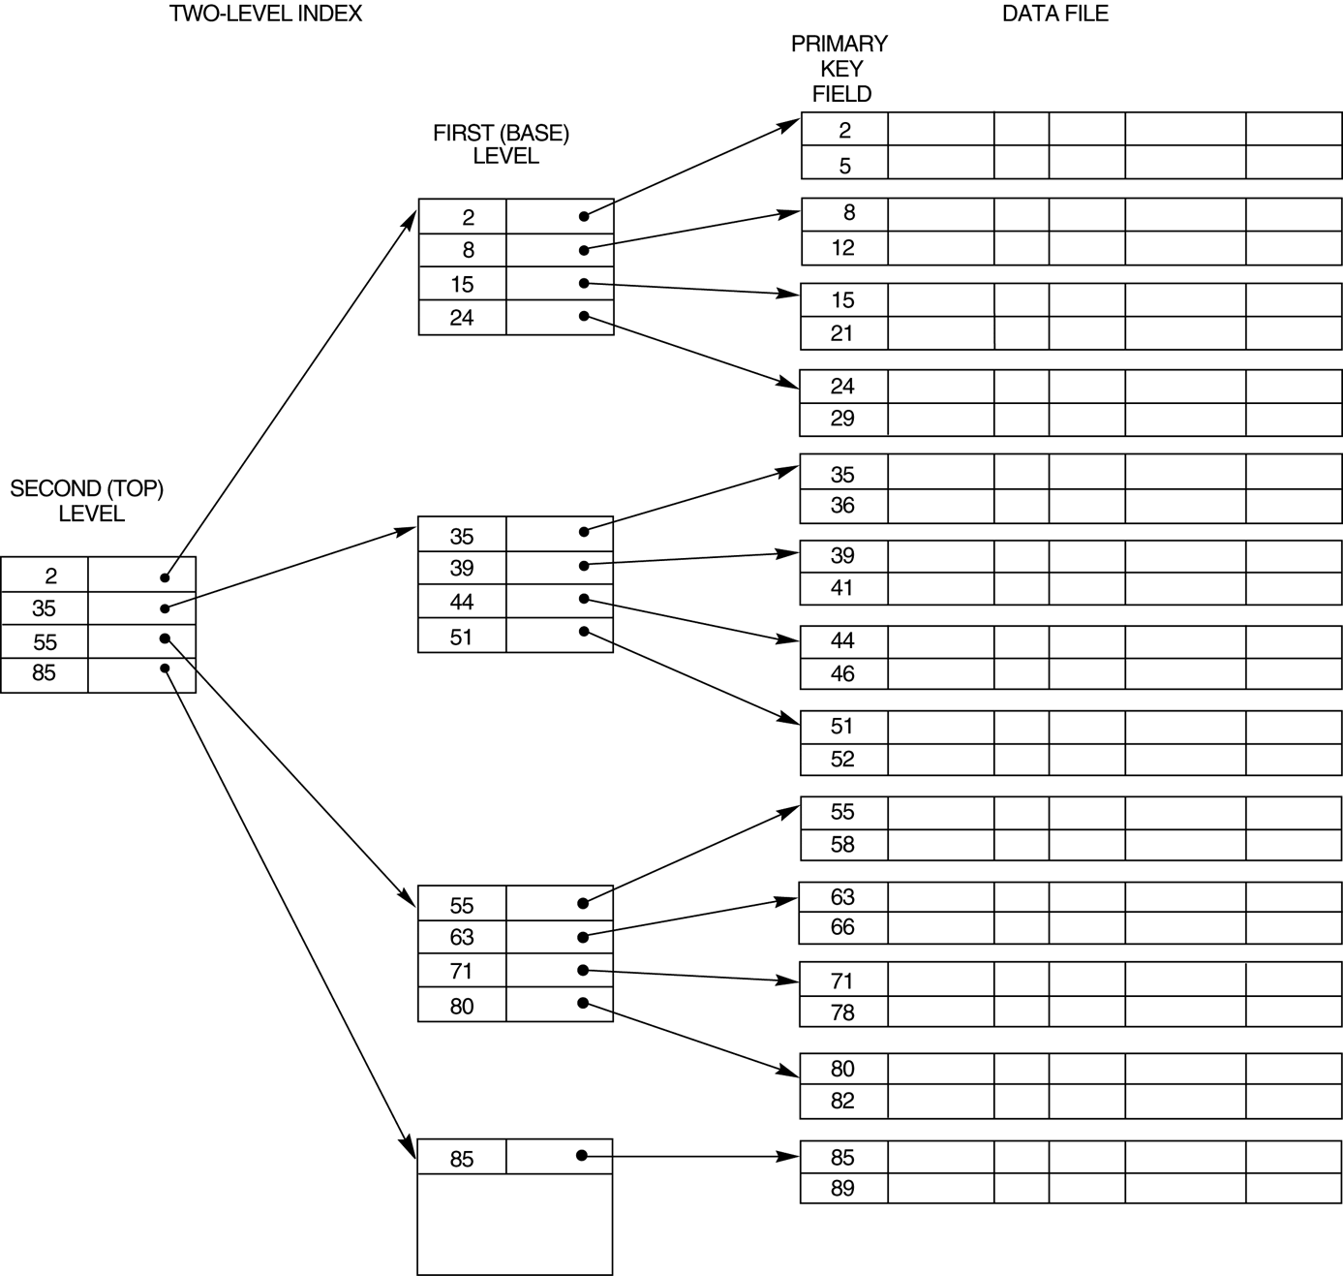
Multilevel Index
Notes:
But what if your index gets so big that, even sparse, it’s too big to fit in main memory?
Index your index.

Slide 18
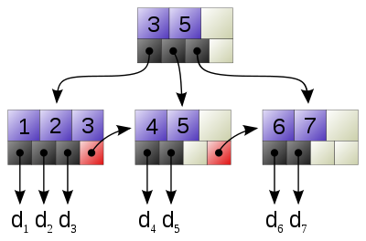
Structure of Indices
Name
Alabama
Alaska
Arizona
Arkansas
California
….
Hawaii
Idaho
….
Kansas
….
New york
….
Rhode Island
….
Vermont
Notes:
Remember that when we first saw this index, we said that it was fast to search because it was sorted.
Like using a phone book, we used a binary search, which allows us to eliminate half the index, then half of the remaining, then half of the remaining, and so on.
In practice, we can get even better performance with indices.
Imagine that instead of dividing the index in half and eliminating one half, you could, in one step, divide it in thirds and eliminate 2/3. Or divide it in fourths and eliminate ¾. That would make the search even faster.
This is achieved by storing the index not as, essentially, an array, like we see here, but in a hierarchical structure called a B+ tree.
Imagine we have indexed an IDENTITY primary key. The only values are 1 to 7.
The top node, the root, has two values in it (3 & 5) that divide the data set up into approximate 1/3
That node has pointers to three children k<=3, 3<k<=5, k>5.
You look in the root node, compare the value you’re hunting for to the values you find there, and follow the pointer to the correct child.

Slide 19
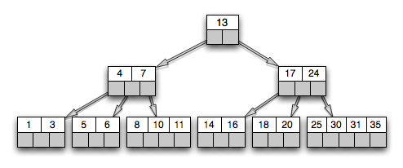
B+ Tree
Notes:
B+ trees are complicated data structures that grow and change as more records are inserted according to elegant algorithms.
As the data set grows, the B+ tree gets wider more quickly than it gets taller, thus getting to a leaf (where the pointer to the record is) remains fast.
A typical “fan-out” for a production B+ tree is more than 100, allowing you to eliminate a large proportion of the unwanted records at each step down the tree.
The details of the management of B+ tree is out of scope for this paper, but let me know if you want more detailed references.

Slide 20
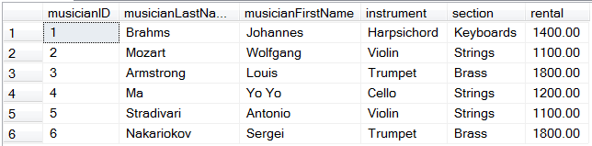
Bitmap Index
Brass | Keyboards | Percussion | Strings
0 | 1 | 0 | 0
0 | 0 | 0 | 1
1 | 0 | 0 | 0
0 | 0 | 0 | 1
0 | 0 | 0 | 1
1 | 0 | 0 | 0
Notes:
The types of indices we have been discussing are most efficient when the index key has a wide range of values, and few occurrences per value, as this maximises the selectivity of the index, minimising the number of records to be returned, and hence, the number of disk accesses
Having an index on, say, gender isn’t really worth the effort, because you have to deal with such a large record set anyway.
The bitmap index, however, is another kind of index that works best on keys that have a small set of values.
This kind of index is stored as a simple table, like a two-dimensional array
Each cell holds a single bit
Each row corresponds to a row in the table to which the index is bound
Each column corresponds to a single possible value of the attribute being indexed
As shown in the figure

Slide 21
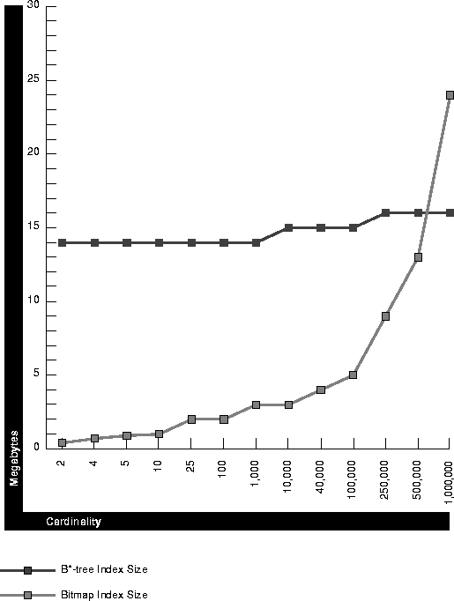
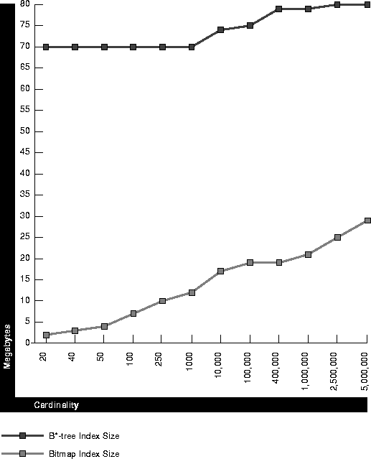
Bitmap Index
Advantages
Size
Notes:
A B-tree index must contain all of the key values for every record (and that’s just the leaf nodes). If keys are large, then the tree is large.
However, a bitmap index uses only one bit to represent each value.
In addition, the bitmap structure is highly suitable for compression
Thus bitmap indexes are much smaller than B-trees
This advantage is more pronounced the lower the cardinality of the indexed attribute
The advantage is more pronounced for larger databases (1,000,000 rows on the left; 5,000,000 on the right)

Slide 22
Bitmap Index
Advantages
Computation Speed
staffID | fName | lName | Position | Salary | Branch No
SL21 | John | Smith | Manager | 42000 | B5
SG37 | Ann | Jones | Assistant | 24000 | B3
SG14 | David | Howe | Assistant | 22000 | B3
SA9 | Mary | Leeson | Supervisor | 67000 | B7
SG5 | Susan | Beech | Manager | 53000 | B3
SL41 | Julie | Arbuthnot | Assistant | 17000 | B5
Manager | Assistant | Supervisor
1 | 0 | 0
0 | 1 | 0
0 | 1 | 0
0 | 0 | 1
1 | 0 | 0
0 | 1 | 0
B3 | B5 | B7
0 | 1 | 0
1 | 0 | 0
1 | 0 | 0
0 | 0 | 1
1 | 0 | 0
0 | 1 | 0
Notes:
Certain types of operations are especially efficient when you have bitmapped indices
For example, you can do counts quite easily from the index alone, without accessing the database. Just sum the corresponding column.
And you can also do certain costly joins very cheaply
Imagine we have this table and we want to select supervisors from branch B3
With only traditional indices this requires grabbing all the records and performing equality comparison on each pair of supervisor and branch fields
With the bitmap indices, however, you just.....do a bitwise AND on the two columns

Slide 23
Bitmap Index
Disadvantages
Very high overhead to maintain
Not available in SQL Server
Notes:
A modification to a bitmap index requires a great deal more work on behalf of the system than a modification to a b-tree index.

Slide 24
How are Indexes Used
Automatic
For each query, the DBMS determines if there is a relevant index.
It then determines whether using the index will speed up the query processing.
Notes:
So you don’t have to do anything
We will look more closely at this “system decides what to do” business when we discuss query processing and optimisation next time.

Slide 25
How are Indexes Created
All Primary Key fields are automatically indexed.
You can create your own indices using the CREATE INDEX command
Notes:
And, to allow a sparse index on PK, the table is sorted on PK

Slide 26
How to Create Indexes
CREATE [ UNIQUE ] [ CLUSTERED | NONCLUSTERED ] INDEX index_name
ON <object> ( column [ ASC | DESC ] [ ,...n ] )
[ INCLUDE ( column_name [ ,...n ] ) ]
[ WHERE <filter_predicate> ]
[ WITH ( <relational_index_option> [ ,...n ] ) ]
[ ON { partition_scheme_name ( column_name ) | filegroup_name | default } ]
Notes:
The syntax of CREATE INDEX is complex; we will see it in practical
Note the “clustered” option. Remember what that means?
A clustered index is on a field that is not the primary key, but that is a sort key.
Because the assumption is that the table is sorted on that key, the index can be sparse.
What, therefore, do you think SQL Server does to a table if you create a clustered index on it? (Sorts it)
How many clustered indices can you have on a single table? (one)
SQL Server 2008 allows up to 249 non-clustered indices on each table

Slide 27
Multi-Column Index
Note that indexes can be made on more than one column.
The index entry is then a combination of values on the involved columns.
Notes:
Why would you do this?
If you often sort, join or filter on a multi-column comparison

Slide 28
Index Issues
Indexes speed retrieval.
What impact do they have on insertion, deletion and update?
Indexes take up space
So index only those fields that will benefit from being indexed.
Notes:
You’ve got a nice sparse clustered index with the value of the record at the start of a block.
You insert a new record, and the guy at the start of the block changes. What happens to your index? It has to be rebuilt completely.
Same with deletion, and update on variable length fields.
So it’s a tradeoff
Indexes take up space. Eventually if you index enough columns, you might as well be working with the whole table.

Slide 29
What to Index
Fine tuning indexes requires a detailed inspection of queries and performance.
Notes:
We will look at this in practical
But there are some general guidelines

Slide 30
What to Index
General Guidelines
Every table should have at least one primary or clustered index on the most common search key.
Concentrate indexes on tables that are searched often and modified rarely.
Indexes should be considered on all columns that are frequently accessed by the WHERE, ORDER BY, GROUP BY, TOP, and DISTINCT clauses.
Notes:
We will look at this in practical
There are some general guidelines

Slide 31
What to Index
General Guidelines
Create nonclustered indexes on columns that are frequently used in join conditions in queries
Avoid indexing a column with few unique data values. The record set produced will be so large that little benefit is gained.
Avoid indexing small tables. The search efficiency gains will not offset the overhead.
Notes:
We will look at this in practical
There are some general guidelines

Slide 32
Other Modifications
Distributing tables physically
Tables can be partitioned horizontally (row sets) or vertically (column sets)
Sets that are usually accessed together can be placed together on disk to minimise I/O
Notes:
Consider vertical partitioning carefully, though.
A vertical partitioning requires duplication of the primary key for each row
It also requires join operations to put the table back together again

Slide 33
Other Modifications
Storing derived data
Values that are regularly computed by calculations of attributes can be stored precomputed in the database as an additional attribute
Notes:
Upside: No computations required
Downside: Update anomalies now possible if input values change and derived values are not updated.

Slide 34
Other Modifications
Combining tables
One-to-one relationships can be collapsed into a single table
Notes:
Advantage: no join when both fields required
Disadvantage: Slower when only one is required, because the records are bigger
To decide? Obviously must have very detailed knowledge of the database actual, not theoretical, usage.

Slide 35
Other Modifications
Denormalisation
Third-normal form tables can be combined by reproducing columns as required (introducing redundancy)
Notes:
Remember how we took owner out of the dog show table?
Now our data were protected, but to get the owner requires a join
So, to eliminate the join, we can put it back
This of course introduces all the problems that normalisation solved for us.
Very risky, and going out of fashion rapidly as hardware and DBMS algorithms improve

Slide 36
Other Modifications
Duplication
Notes:
If user competition for access is hurting response times, and you have tried everything else you can possibly think of, you can always make multiple copies of the database, and direct different users or applications to different copies
The hideous downside of this should be obvious
To make it slightly less awful, you can duplicate only the most popular parts of the database.

Slide 37
Exercises
Notes:
Our discussion today has been focusing on principles, concepts and theory.
So will our exercises.
Remember that we will have a chance to see these things in action later in the term.

